Slide 1
Quarterly HR Community Meeting
Human Resources Administration
August 18, 2020

Slide 2
Quarterly HR Community Meeting AGENDA August 18, 2020, 10:00am – 12:00pm Via GoToWebinar
Welcome Al Howell
Making the “New Normal” Work
Agency HR Perspectives Brian Robinson, DOT
Courtney Ware, TCSG
Remote Recruiting Monique Jenkins
Telework Bo McDaniel
“New Normal” Questions and Answers Al Howell, Moderator
Panel of SMEs
Benefits Updates Leneequa Morris
Carla Gracen
Meeting Wrap-up Al Howell

Slide 3
Welcome
Al Howell

Slide 4
Making the New Normal Work Agency HR Perspectives
Brian Robinson, Deputy HR Director
Georgia Department of Transportation

Slide 5
Making the New Normal Work Agency HR Perspectives
Courtney Ware, HR Director
Technical College System of Georgia

Slide 6
Making the New Normal Work Telework
Bo McDaniel, Director
Talent Management and Policy

Slide 7
Making the New Normal Work Virtual Recruiting
Monique Jenkins, Manager
Enterprise Talent Management Services

Slide 8
Considerations for Virtual Recruiting
Review current interview process
Embrace current technology
Create how to videos/instructions for hiring mangers

Slide 9
Considerations for Virtual Hiring
Automate new hire form completion process
Adapt onboarding to the virtual environment
Encourage managers to transition to virtual check-in meetings

Slide 10
Making the New Normal Work: Questions and Answers
Al Howell, DOAS, Moderator
Panel of Experts
Monique Jenkins, DOAS Bo McDaniel, DOAS
Brian Robinson, DOT Courtney Ware, TCSG

Slide 11
Benefits Updates
Leneequa Morris
Carla Gracen
Jill Simms

Slide 12
2020 Open Enrollment for Plan Year 2021
October 19, 2020 at 12:00 a.m. ET and ends November 6, 2020 at 11:59 p.m. ET
__________________________________
During Open Enrollment, eligible active employees may:
Enroll in Flexible Benefits coverage
Change Plan Option and/or Vendor
Enroll eligible dependents
Drop covered dependents
Decrease or increase coverage tier
Discontinue Flexible Benefits plan option(s)

Slide 13
2021 Flexible Benefits Program Changes and Other Updates
The 2021 Health Care Flexible Spending Account (FSA) will increase to $2,700.00
UNUM’s Long-Term Care premiums will increase by 12%
Benefit Fairs will be virtual
Important Note: Flexible Spending Accounts (Dependent care and Health care) do not automatically roll over. If you want to continue your FSA(s) contributions for the 2021 plan year, you must re-enroll during this OE period.

Slide 14
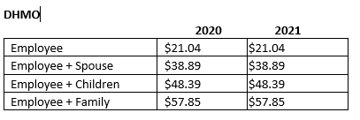
Dental RFP for Plan Year 2021
DHMO
RFP Notice of Intent to Award – Cigna
The incumbent vendor
If awarded, contract pricing will be effective for Plan Year 2021. The pricing did not change.
The $.70 administrative fee is not included in the monthly rates above.
Rates are guaranteed through Plan Year 2024.
Coverage did not change.
PPO
RFP Notice of Intent to Award – Cigna
If awarded, contract pricing will be effective for Plan Year 2021.
*PPO award is under protest
The $.70 administrative fee is not included in the monthly rates above.
Rates are guaranteed through Plan Year 2023.
.Coverage changes include:
No waiting periods on major and orthodontia services
No frequency limitation of certain services, e.g., extraoral x-rays
Orthodontia lifetime maximum benefit will reset to $0 at contract transition

Slide 15
Pet Insurance RFP for Plan Year 2021
RFP Notice of Intent to Award issued to two Pet Insurance vendors: MetLife and Nationwide.
For PY 2021, the actual pricing will be determined on an individual pet-basis when the employee enrolls for coverage.
The $.70 administrative fee is not included in the monthly rates above.
The rates are guaranteed through Plan Year 2021.
Coverage details will be communicated as part of the Open Enrollment process.

Slide 16
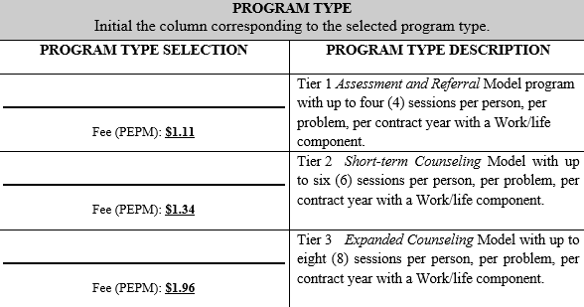
Employee Assistance Program RFP for FY2021
EAP
RFP Award – Kepro
The incumbent vendor
Contract pricing will be effective for Plan Year 2021, effective August 1, 2021.
The pricing will be reduced for 4-visits and 6-visits; and will increase for 8-visits.
HRA is working with Kepro regarding the implementation of the new Participation Agreement.

Slide 17
GASCCP 2020-2021 Campaign
87 applications received:
70 Independent Charities
17 Federations
742 Total Independents, Federations and Federation-Covered Charities
All applicants were approved
GASCCP Coordinator Training will be held at the end of August 2020.
Training will be recorded for replay.
The 2020-2021 Campaign will be September 16, 2020 to November 16, 2020
Due to COVID-19, the campaign will promote 100% virtual participation.
Details will be posted in the GASCCP Website pages and discussed in the Training.
Weekly activity ideas for the virtual campaign will be provided.
Special “Thank You” to Jill Simms and Hannah Mayes for their recommendations and planning for the upcoming campaign!

Slide 18
Meeting Wrap-up
Al Howell

Slide 19
Status Update on the Eligibility and Enrollment System and Services 2019 Contract
In 2017, DCH and DOAS initiated a project to procure a single eligibility and enrollment vendor with a multi-dimensional benefits administration platform to support the State’s complex and diverse employee benefits programs.
After thorough analysis and requirements definition, DCH and DOAS issued an RFP to procure the services of a single vendor for both agencies.
In November 2019, DCH and DOAS awarded the contract to Alight Solutions. The award of the contract was protested by an unsuccessful supplier.
After an eight-month protest process, the decision to award the contract to Alight was upheld, and DCH and DOAS entered into an agreement with Alight.
DCH and DOAS are currently working with Alight on developing the implementation plan.

Slide 20
Status Update on the Eligibility and Enrollment System and Services 2019 Contract, cont.
Single benefits portal for employees to enroll in medical and flexible benefits
Financial management services including customer billing, fee collection and payment processing (new service).
Dependent verification services (replaces the current manual process).
Consolidated medical and flexible benefits analytics and reporting for the shared employee groups (new service).
Single source of data for DOAS to calculate employee total rewards statements (operating efficiency).
Cost neutral pricing that includes the following additional services and operating efficiencies:
Improved agency billing and payroll deduction reconciliation processes (improved processes).

Slide 21
Preventing Sexual Harassment FY21 Annual Training Dates to Remember
June 25, 2020
DOAS sends training count survey link
Provide DOAS an updated list of supervisors and managers
Determine your total employee, supervisor, and manager counts
September 30, 2020
Deadline to submit agency employee count of employees, supervisors and managers as of July 1 and count that completed training by September 30
October 15, 2020
Deadline for annual training completion by employees, supervisors and managers
July 1, 2020
Training counts can be submitted any time before October 15

Slide 22
2020 HR Community Meeting Dates
November 10, 2020

Slide 23
Other Upcoming HR Meetings
Tuesday, August 18th – Employee Benefit Plan Council Meeting
Tuesday, October 13th – Employee Benefit Plan Council and State Personnel Board Meetings

Slide 24
Georgia Council for Human Resources (formerly Council for State Personnel Administration) Annual Conference – September 24 - 25

Slide 25
Meeting Feedback
Please share your thoughts on today’s meeting by completing our survey:
https://www.surveymonkey.com/r/C7787Y2

Slide 26
404-463-7054

